Slide 1
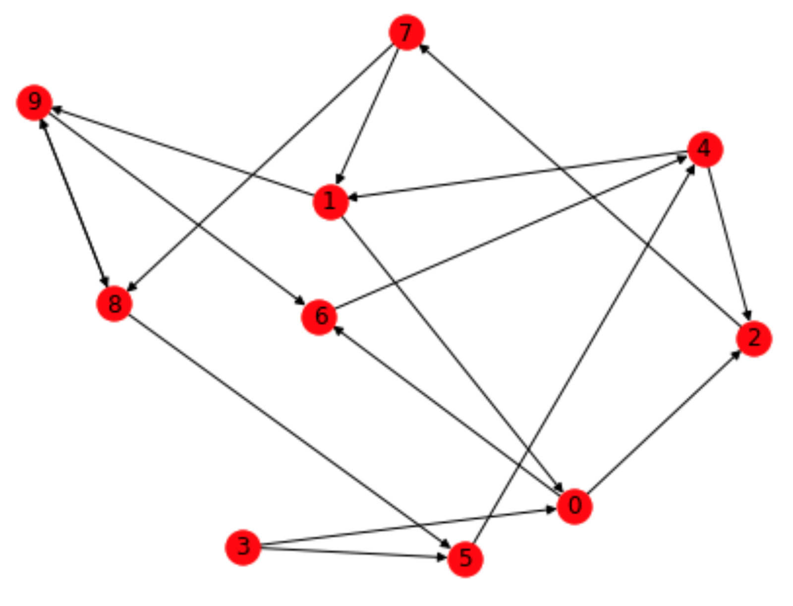
Transforming Structured Finance Compliance with AI
Automating the Conversion of Unstructured Financial Data into Structured, Regulatory-Compliant Assets
Hackathon Name & Date: Structured Finance Hackathon 2025
Team/Project Name: TEAM TONIC

Slide 2
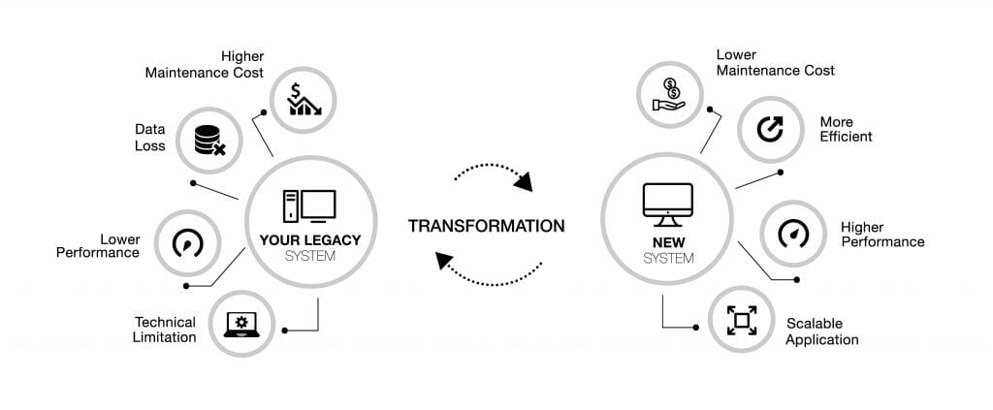
The Challenge in Structured Finance
Manual processes in complex financial deal structuring, compliance, and risk management
Legacy systems using Java & Rosetta complicating modern automation
A 350‑page ESMA compliance report that must be translated into machine-readable format

Slide 3
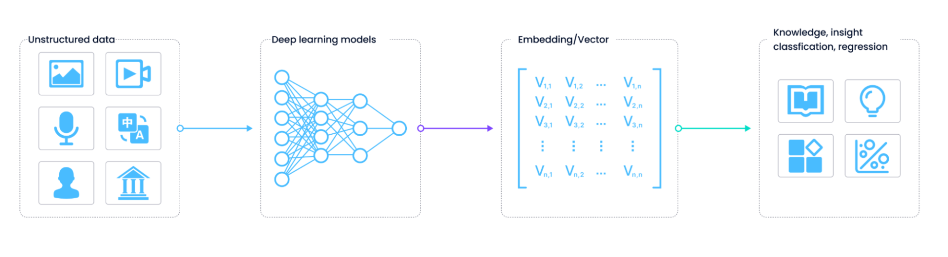
Our Vision
Develop an AI model that reads raw, unstructured financial data and generates structured, compliant outputs
Bypass legacy “monolithic” systems by leveraging modern frameworks (e.g., FastAPI, Python)
Bridge the gap for regulatory compliance through automated data extraction and transformation

Slide 4
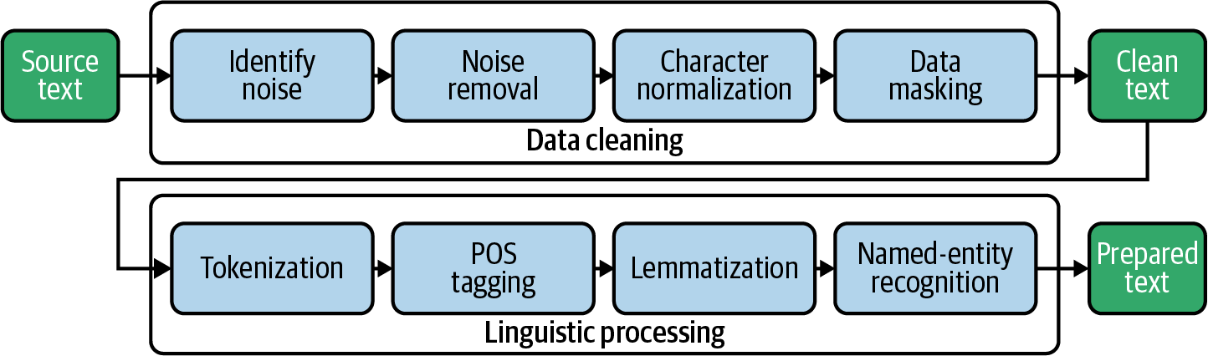
Phase 1: Converting Raw Data to an Annotated Dataset
PDF Ingestion & Conversion:
Use PDF-to-LaTeX/Markdown tool to convert the ESMA report and other research sources
Data Chunking:
Segment converted text into manageable parts and load into a Pandas DataFrame
Annotation & Analysis:
Apply NLP (e.g., NER using spaCy or Hugging Face) to label key entities and regulatory markers
Benchmarking:
Establish baseline performance metrics for compliance extraction (precision, recall, etc.)

Slide 5
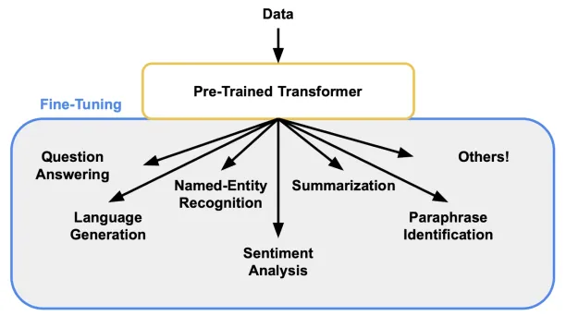
Phase 2: From Annotated Data to a Fine-Tuned Model
Dataset Transformation:
Convert the enriched, annotated dataset into a ChatML-compatible training format
Model Selection & Fine-Tuning:
Utilize the Osmosis-Structure-0.6B model for structured data tasks
Fine-tune the model on your specialized dataset for extracting structured financial events
Evaluation Benchmark:
Develop an evaluation benchmark to test the model’s performance in generating compliant outputs

Slide 6
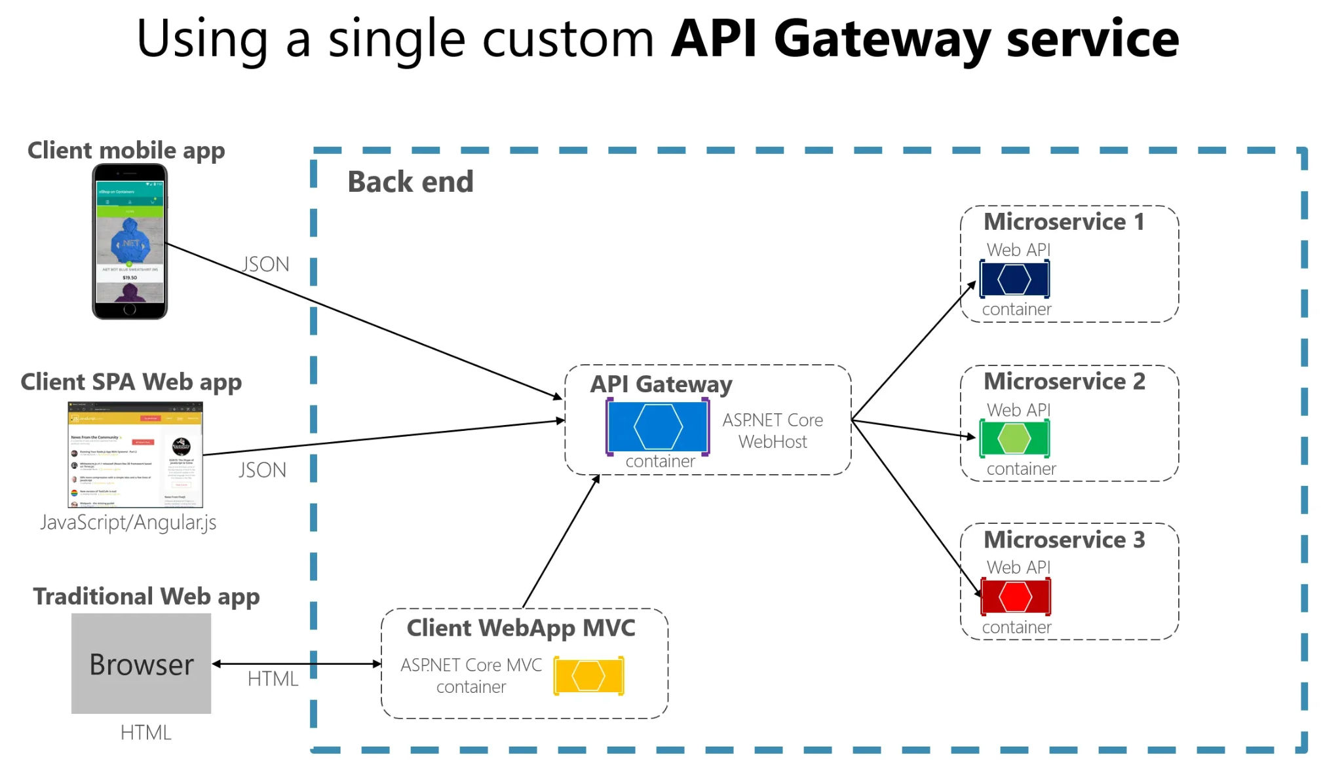
System Integration & API Development
FastAPI Server:
Create a lightweight, modern API to expose model functionalities
Allow seamless integration with external systems and agentic models
Demo Application:
Build a demo app that pulls raw data from the Open Bank Project Sandbox
Showcase how the API transforms this data into structured financial asset

Slide 7
Expected Impact & Future Vision
Rapid transformation from unstructured regulatory text to structured financial data
Elimination of dependence on legacy systems (Java/Rosetta)
A scalable pipeline that can ultimately integrate seamlessly with full DRR workflows and regulatory system

